Slide 1


WELCOME
Welcome to the Presentation
Engineering economics
Course Code: GED 221
MD Abdullah Al Noman
Lecturer , DBA, BAIUST
Bangladesh Army International University of Science and Technology

Slide 2
CONSTITUENTS OF THE PRESENTATION
Introduction
Early definitions given by Marshall and Robbins
Changing perspectives of Economics
The Economic problem: Scarcity and Choice
Kinds of Resources
Central Problems of an Economy
How are the central problems solved
The Scope of Economics
Microeconomics and allocation of Resources
Microeconomics and economic efficiency
Importance and Uses of Microeconomics
Positive and Normative Economics

Slide 3
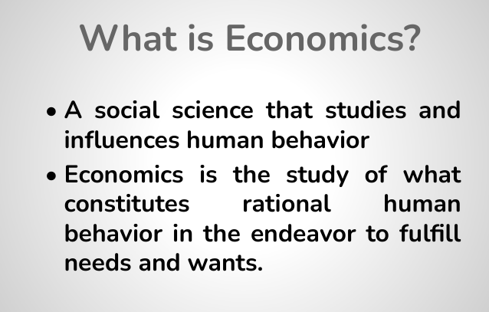

Slide 4
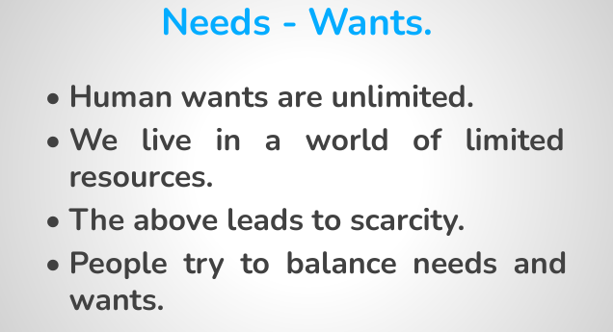

Slide 5
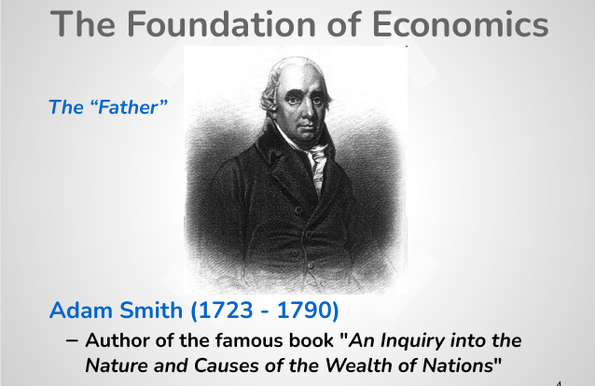

Slide 6
Early definitions of Economics
Wealth Definition: The Wealth Definition of Economics is most commonly associated with Adam Smith, who is often referred to as the "Father of Economics." In his seminal work, An Inquiry into the Nature and Causes of the Wealth of Nations (1776), Smith defined economics as a science focused primarily on the study of wealth creation, accumulation, and distribution.
The Wealth Definition defines economics as the study of wealth creation, accumulation, and distribution. It focuses on understanding how societies produce and manage material wealth to promote prosperity.
Welfare Definition: The Welfare Definition of economics, introduced by Alfred Marshall, defines economics as the study of people in the ordinary business of life. It focuses on how individuals and societies use resources to improve well-being and achieve material welfare, extending beyond wealth to consider human happiness and quality of life.
Scarcity Definition: Robbins shifted the focus of economics from wealth and welfare to scarcity and choice. "Economics is the science which studies human behavior as a relationship between ends and scarce means which have alternative uses.“

Slide 7
Changing perspective of Economics
Economics as a Study of Wealth. Adam Smith in his well-known book ‘Wealth of Nations’ defined economics as ‘an enquiry into the wealth of nations. Thus Adam Smith laid emphasis on the expansion of wealth and riches of a society as a subject matter of economics. Another classical
economist David Ricardo shifted the emphasis from the expansion of wealth to the distribution of
wealth. Ricardo writes, “The produce of the earth all that is derived from its surface by the united
application of labour, machinery and capital is divided among three classes of the economy namely,
the proprietor of the land, the owner of the stock of capital necessary for its cultivation and the
labourers by whose industry it is cultivated”. He further writes, “To determine the laws which regulate this distribution is the principle problem in political economy”.

Slide 8
Changing perspective of Economics
Economics as a Science of Material Welfare of Man
Another drawback in making economics a “science of wealth” by classical economists may be
noted. By laying conspicuous emphasis on wealth and put man to the secondary place in economic
studies they did not lay adequate stress on man’s behaviour in relation to wealth. Nor did they
emphasise the end or ultimate objective of economics which is the promotion of human and social
welfare. As a matter of fact, wealth is only a means to an end, the end being the welfare of man and
society. To regard wealth as the be-all and the end-all of economic science is to make the means as
the end. The credit goes to Alfred Marshall, a prominent English economist, for shifting the emphasis
from wealth to man and also from wealth to welfare. According to him, economics is “on the one
side a study of wealth; and on the other; and more important side, a part of the study of man”.6 He
further writes, economics examines that part of individual and social action which is most closely
connected with the attainment and with the use of material requisites of well-being”.7

Slide 9
Changing perspective of Economics
Economics as a Study of Allocation of Scarce Resources
However, a leading British economist Lionel Robbins in the early thirties put forward an alternative
view of economics. He pointed out that the economic problem arises because of scarcity of
resources in relation to human wants. The scarcity of resources and unlimited wants of the people
necessitates choice regarding what wants to be satisfied and, therefore, the particular allocation of
scarce resources among various goods and services. He thus writes, Economics is the science which
studied human behaviour as a relationship between ends and scarce means which have alternative
uses”. Thus Robbins lays stress on three facts, namely (1) human wants are unlimited, (2) the

Slide 10
The Economic problem: Scarcity and Choice
Economics is mainly concerned with the achievement and use of material requirements to satisfy human wants. Human wants are unlimited and productive resources such as land and other natural resources, skilled labour, raw materials, capital equipment with which to produce goods and services to satisfy those wants are scarce or limited. Thus, goods and services which satisfy human wants are scarce because productive resources with which to produce goods and services are scarce.
The problem of scarcity of resources is felt not only by individuals but also by the society as a whole. With wants being unlimited and resources scarce, we individually as well as collectively cannot satisfy all our wants. This gives rise to the problem of how to use scarce resources to attain
maximum possible satisfaction of the people. This is generally called ‘the economic problem’ as it lies at the root of all economic problems faced by the society. Every economic system, be it capitalist, socialist or mixed, has to contend with this central problem of scarcity of resources relative to wants for them.

Slide 11
Kinds of Resources
Labour. Labour represents all physical and mental abilities which people can make available for production of goods and services. Labour is usually measured by the time spent in working during a period.
Land. In economics, land includes all natural resources which are free gift of nature. Thus, by
land economists do not mean only agricultural soil but also other natural resources such as minerals, water, climate and forests.
Capital. Capital refers to man-made resources of production. Capital includes equipment, factorybuildings, all sorts of tools, machines, roads, dams, transport buses, trucks etc. These are often called capital goods which help in the production of further goods and services. Since these capital goods are man-made, they can be produced more every year. In this way capital formation every year adds to the stock of capital and increases our capacity to produce goods and services. Capital formation in a year is also called real investment.
Entrepreneurship. Entrepreneurship represents a special human resource which provides his
entrepreneurial ability or what is also called enterprise. Entrepreneur plays a crucial role in a free
market economy. It is he who initiates and organises the production process by combining other
resources such as labour, capital and land. Entrepreneur takes various business-policy decisions and bears risk of loss from his venture. Another important task of an entrepreneur is to introduce
innovations such as the use of new and better techniques of production, launching of new products.

Slide 12
Central Problems of an Economy
The scarcity of resources relative to human wants gives rise to various basic problems, issues or questions which have to be solved by an economy if it is to fulfil its purpose.
These basic economic problems are also called central problems of the economy. All these problems involve choice to be made by the society. These problems are ;
1. What to produce
2. How to produce
3. For Whom to produce
4. What Provision (if any) be made for economic growth.

Slide 13
How these problems are solved
1. Free market economies
A free market economy is a type of economy that promotes the production and sale of goods and services, with little to no control or involvement from any central government agency. This economic system is primarily based on supply and demand.
In a free-market economy, firms and households act in their own self-interest to determine how resources get allocated, what goods get produced, and who buys the goods.
laissez-faire economics (a term often used synonymously with the idea of the free market).
A purely capitalist economy is a free market economy; the profit motive drives all commerce and forces businesses to operate as efficiently as possible.

Slide 14
How these problems are solved
1. Free market economies
A free market economy is one that is governed strictly by the forces of supply and demand with no governmental influence. In practice, however, nearly all legal market economies must contend with some form of regulation. A pure market economy has no barriers to economic exchange: you can sell anything to anyone else for any price.
In reality, this form of economics is rare. Sales taxes, tariffs on imports and exports, and legal prohibitions—such as the age restriction on liquor consumption—are all impediments to a truly free market exchange.
Hong Kong's economy is considered the most free, followed by New Zealand while Algeria was the least free in 2019, according to the 2019 Index of Economic Freedom.

Slide 15
How these problems are solved
2. Command economies
A command economy is a system where the government, rather than the free market, determines what goods should be produced, how much should be produced, and the price at which the goods are offered for sale. It also determines investments and incomes.
The command economy is a key feature of any communist society. Cuba, North Korea, and the former Soviet Union are examples of countries that have command economies, while China maintained a command economy for decades before transitioning to a mixed economy that features both communistic and capitalistic elements.

Slide 16
How these problems are solved
2. Command economies
Also known as a planned economy, command economies have as their central tenet that government central planners own or control the means of production within a society. Private ownership or land, labor, and capital is either nonexistent or sharply limited to use in support of the central economic plan.
In contrast with free market economies, in which the prices of goods and services are set by supply and demand, central plans in a command economy set prices, control production, and limit or entirely prohibit competition within the private sector. In a pure command economy, there is no competition, as the central government owns or controls all business.

Slide 17
How these problems are solved
3. Mixed economies
There is a third type of economy involving a combination of market forces and central planning, called mixed economies.
Mixed economies may have a distinct private sector, where resources are allocated primarily by market forces. Mixed economies may also have a distinct public sector, where resources are allocated mainly by government, such as defence, police, and fire services.
A mixed economic system protects private property and allows a level of economic freedom in the use of capital, but also allows for governments to interfere in economic activities in order to achieve social aims.

Slide 18
How these problems are solved
Conclusion:
Free market economies and command economies exist more as concepts than as tangible realities; almost all of the world's economies feature elements of both systems and are classified as mixed economies.
For example, although the United States allows companies to set prices and workers to negotiate wages, the government establishes parameters such as minimum wages that must be followed. Additionally, most countries have some type of taxation and impose import and export tariffs.

Slide 19
The Scope of Economics
The scope of economics refers to what is the subject matter of economics, that is, what are the various issues and questions that are analysed in it. Besides, in the scope of economics we deal with the issues of positive and normative economics. In what follows we shall discuss the subjects of microeconomics and macroeconomics as well as positive and normative economics. The subject-matter of economics has been divided into two parts : Microeconomics and Macroeconomics. These terms were first coined and used by Ragnar Frisch and have now been adopted by economists all the world over. Nowadays one can hardly come across a text-book on modern economic analysis which does not divide its analysis into two parts, one dealing with microeconomics and the other with macroeconomics. The term microeconomics is derived from the Greek word mikros, meaning “small” and the term macroeconomics is derived from the Greek word makros,
meaning “large.” Thus microeconomics deals with the analysis of small individual units of the economy such as individual consumers, individual firms and small aggregates or groups of individual units such as various industries and markets. On the other hand, macro-economics concerns itself with the analysis of the economy as a whole and its large aggregates such as total national output and income, total employment, total consumption, aggregate investment.

Slide 20
Microeconomics and allocation of Resources
Microeconomic theory takes the total quantity of resources as given and seeks to explain how they are allocated to the production of various goods. It is the allocation of resources that determines what goods shall be produced and how they shall be produced. The allocation of resources to the production of various goods in a free-market economy depends upon prices of the various goods and prices of the various resources or factors of production. Therefore, to explain how the allocation of resources is determined, microeconomics proceeds to analyse how relative prices of goods and factors are determined. Thus the theory of product pricing and the theory of factor pricing (or the theory of distribution) fall within the domain of microeconomics. The theory of product pricing explains how relative prices of cotton cloth, foodgrains, jute, kerosene oil, Vanaspti ghee and thousands of other goods are determined. The theory of distribution explains how wages (price for the use of labour), rent (payment for the use of land), interest (price for the use of capital) and profits (the reward for the entrepreneur) are determined. Thus, the theory of product pricing and the theory of factor pricing are the branches of microeconomic theory.

Slide 21
Microeconomics and Economic Efficiency
Besides analysing the pricing of products and factors and the allocation of resources based
upon the price mechanism, microeconomics also seeks to explain whether the allocation of resources determined is efficient. Efficiency in the allocation of resources is attained when the resources are so allocated that maximises the satisfaction of the people. Economic efficiency involves three efficiencies; efficiency in production, efficiency in distribution of goods among the people (This is also called efficiency in consumption) and allocative economic efficiency, that is, efficiency in the direction of production. Microeconomic theory shows under what conditions these efficiencies are achieved. Microeconomics also shows what factors cause departure from these efficiencies and result in the decline of satisfaction from the maximum possible level.

Slide 22
Importance and Uses of Microeconomics
Microeconomics occupies a vital place in economics and it has both theoretical and practical
importance. It is highly helpful in the formulation of economic policies that will promote the
welfare of the masses. Till recently, especially before Keynesian Revolution, the body of economics
consisted mainly of microeconomics. In spite of the popularity of macroeconomics these days,
microeconomics retains its importance, theoretical as well as practical. It is microeconomics that
tells us how a free-market economy with its millions of consumers and producers work to decide
about the allocation of productive resources among the thousands of goods and services. As
Professor Watson says, “microeconomic theory explains the composition or allocation of total
production, why more of some things are produced than of others.”7 He further remarks that
microeconomic theory has many uses. The greatest of these is depth in understanding of how a free private enterprise economy operates.”8 Further, it tells us how the goods and services produced are distributed among the various people for consumption through price or market mechanism.

Slide 23
Positive and Normative Economics
It is important to know the difference between positive economics and normative economics. Positive economics is concerned with explaining ‘what it is,’ that is, it describes theories and laws to explain observed economic phenomena, whereas normative economics is concerned with ‘what should be’ or ‘what ought to be’ the things. J.N. Keynes drew the distinction between the two types of economics in the following manner: “A positive science may be defined as a body of systematized knowledge concerning what it is; normative science or a regulative science as a body of systematized knowledge relating to criteria of what ought to be, and concerned with the ideal as distinguished from the actual.... The objective of a positive science is the establishment of uniformities (that is, scientific laws); of a normative science, the determination of the ideals.

